Slide 1
Modern Programming Languages
UIIT PMAS Arid Agriculture University, Rawalpindi
Course Instructor: Suleman Khurram

Slide 2
Graphical User Interfaces in Java
The fundamental elements that you need to create a GUI reside in two packages, java.awt and javax.swing.
The java.awt package was the primary repository to create GUI in Java1.1 (awt being an abbreviation for Abstract Windowing Toolkit)
but many of the classes this package defines have been superseded in Java 2 by javax.swing

Slide 3
Java Foundation Classes (JFC)
JFC is a general set of GUI programming capabilities. It contains the following set of packages for creating GUI
Swing component classes, such as those defining buttons and menus, but also
Classes for 2D drawing from the java.awt.geom package
Classes that support drag-and-drop capability in the java.awt.dnd package.
The JFC also includes an application program interface (API) defined in the javax.accessibility package that allows applications to be implemented that provide for users with disabilities.

Slide 4
Difference b/w AWT and Swing
AWT is platform-dependent
Swing is platform- Independent
Swing is a more powerful package as compared to AWT and offers many enhanced elements as well

Slide 5
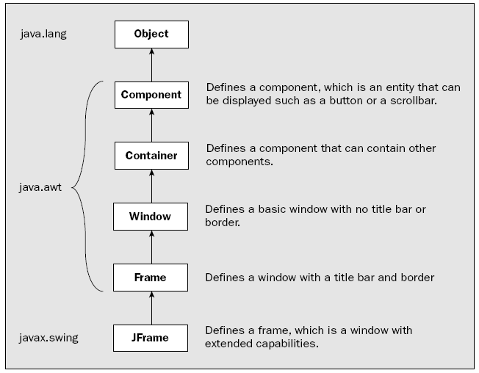
Creating a Window

Slide 6
AWT Example
public class AWTExample2 {
AWTExample2() {
Frame f = new Frame();
Label l = new Label("Employee id:");
Button b = new Button("Submit");
TextField t = new TextField();
l.setBounds(20, 80, 80, 30);
t.setBounds(20, 100, 80, 30);
b.setBounds(100, 100, 80, 30);
f.add(b);
f.add(l);
f.add(t);
f.setSize(400, 300);
f.setTitle("Employee info");
f.setLayout(null);
f.setVisible(true);
}
public static void main(String args[]) {
AWTExample2 awt_obj = new AWTExample2();
}
}
Note: AWT Frame is not closing on clicking on cross, then add following:
f.addWindowListener(new WindowAdapter() {
public void windowClosing(WindowEvent we) {
f.dispose();
}
});

Slide 7
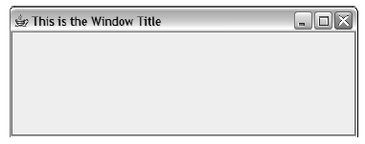
JFrame Window Example
import javax.swing.JFrame;
public class TryWindow {
// The window object
static JFrame aWindow = new JFrame(“This is the Window Title”);
public static void main(String[] args) {
int windowWidth = 400; // Window width in pixels
int windowHeight = 150; // Window height in pixels
aWindow.setBounds(50, 100, // Set position
windowWidth, windowHeight); // and size
aWindow.setDefaultCloseOperation(JFrame.EXIT_ON_CLOSE);
aWindow.setVisible(true); // Display the window
}
}

Slide 8
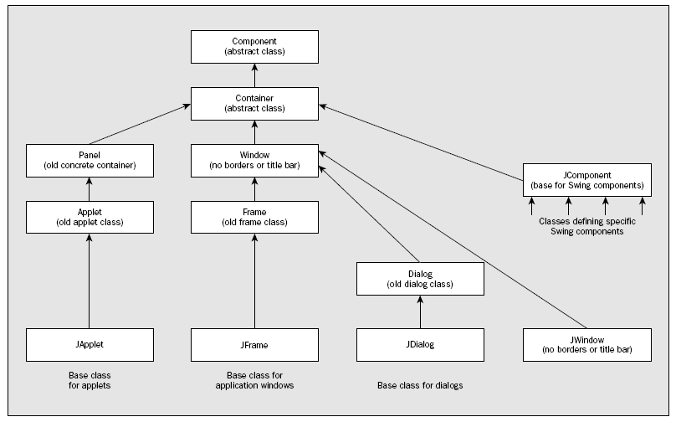
Components and Containers

Slide 9
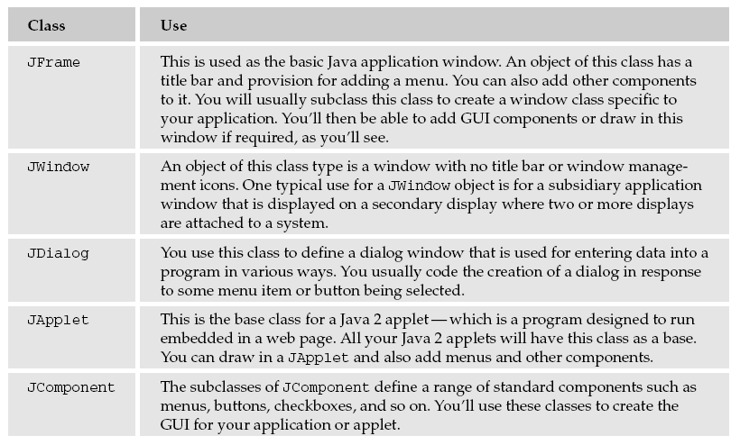

Slide 10
Basics of Components
Component properties/attributes
The position is stored as (x, y) coordinates. This fixes where the object is in relation to its container in the coordinate system of the container object.
The name of the component is stored as a String object.
The size is recorded as values for the width and the height of the object.
The foreground color and background color that apply to the object. These color values are used when the object is displayed.
The font used by the object when text is displayed.
And many more……

Slide 11
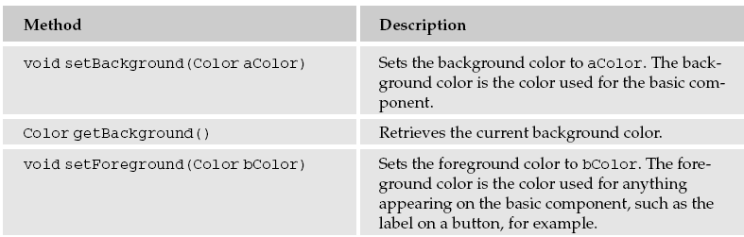
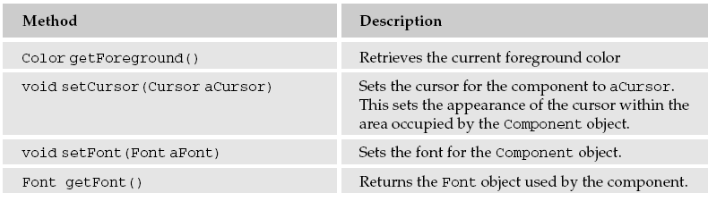
Setting component color and font

Slide 12
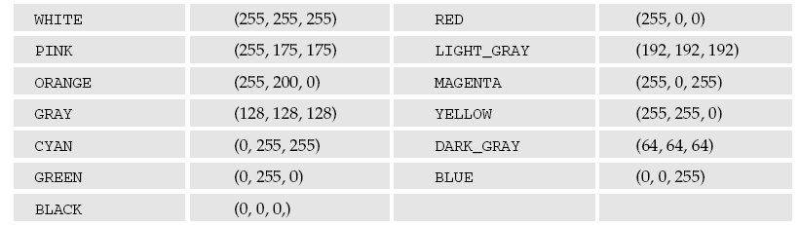
Setting component color and font
Color myBlack = new Color(0,0,0); // Color black
Color myWhite = new Color(255,255,255); // Color white
Color myGreen = new Color(0,200,0); // A shade of green
aWindow.getcontentPane().setBackground(myGreen);

Slide 13
Swing Components
Swing components all have the JComponent class as a base, which itself extends the Component class
All the Swing component classes are defined in the javax.swing package and have class names that begin with J
There are various useful classes in the swing package to deal with GUI
Button
Menus
Text components…

Slide 14
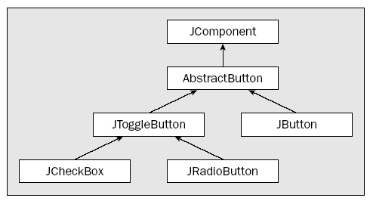

Buttons in Swing

Slide 15
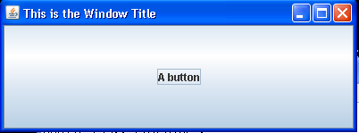
Creating a Swing Button
Container content = aWindow.getContentPane();
JButton myButton=new JButton(“MyButton”);
content.add(myButton);

Slide 16
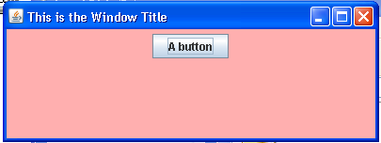
Setting Window Layout
FlowLayout flow = new FlowLayout();
Container content = aWindow.getContentPane(); content.setLayout(flow);

Slide 17
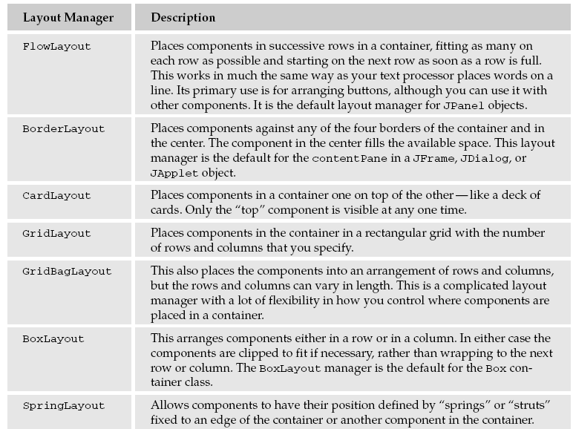
Window Layouts

Slide 18
BorderLayout
The BorderLayout is used to arrange the components in five regions: north, south, east, west, and center.
The BorderLayout provides five constants for each region:
public static final int NORTH
public static final int SOUTH
public static final int EAST
public static final int WEST
public static final int CENTER

Slide 19
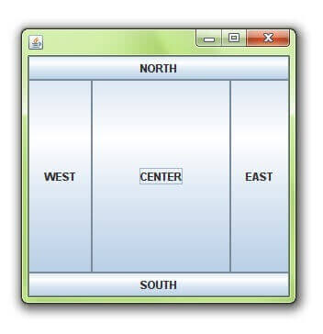
BorderLayout
public class Border
{
JFrame f;
Border()
{
f = new JFrame();
// creating buttons
JButton b1 = new JButton("NORTH");; // the button will be labeled as NORTH
JButton b2 = new JButton("SOUTH");; // the button will be labeled as SOUTH
JButton b3 = new JButton("EAST");; // the button will be labeled as EAST
JButton b4 = new JButton("WEST");; // the button will be labeled as WEST
JButton b5 = new JButton("CENTER");; // the button will be labeled as CENTER
f.add(b1, BorderLayout.NORTH); // b1 will be placed in the North Direction
f.add(b2, BorderLayout.SOUTH); // b2 will be placed in the South Direction
f.add(b3, BorderLayout.EAST); // b2 will be placed in the East Direction
f.add(b4, BorderLayout.WEST); // b2 will be placed in the West Direction
f.add(b5, BorderLayout.CENTER); // b2 will be placed in the Center
f.setSize(300, 300);
f.setVisible(true);
}
public static void main(String[] args) {
new Border();
} }

Slide 20
GridLayout
The Java GridLayout class is used to arrange the components in a rectangular grid. One component is displayed in each rectangle.
GridLayout(): creates a grid layout with one column per component in a row.
GridLayout(int rows, int columns): creates a grid layout with the given rows and columns but no gaps between the components.
GridLayout(int rows, int columns, int hgap, int vgap): creates a grid layout with the given rows and columns along with given horizontal and vertical gaps.

Slide 21
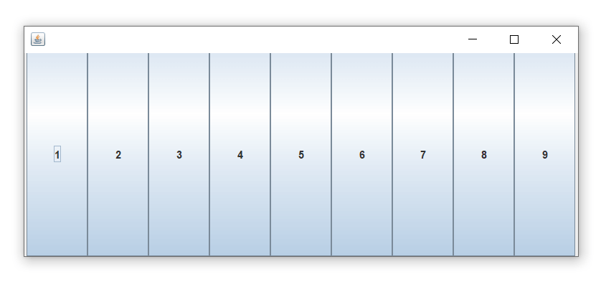
GridLayout
public class GridLayoutExample
{
JFrame frameObj;
GridLayoutExample()
{
frameObj = new JFrame("Test Frame2");
JButton btn1 = new JButton("1");
JButton btn2 = new JButton("2");
JButton btn3 = new JButton("3");
JButton btn4 = new JButton("4");
JButton btn5 = new JButton("5");
JButton btn6 = new JButton("6");
JButton btn7 = new JButton("7");
JButton btn8 = new JButton("8");
JButton btn9 = new JButton("9");
// adding buttons to the frame since, we are using the parameterless constructor, therfore;
// the number of columns is equal to the number of buttons we are adding to the frame. The row count remains one.
frameObj.add(btn1);
frameObj.add(btn2);
frameObj.add(btn3);
frameObj.add(btn4);
frameObj.add(btn5);
frameObj.add(btn6);
frameObj.add(btn7);
frameObj.add(btn8);
frameObj.add(btn9);
frameObj.setLayout(new GridLayout());
frameObj.setSize(300, 300);
frameObj.setVisible(true);
}
public static void main(String argvs[])
{ new GridLayoutExample();
}
}

Slide 22
FlowLayout
The Java FlowLayout class is used to arrange the components in a line, one after another (in a flow). It is the default layout of the applet or panel.
public static final int LEFT
public static final int RIGHT
public static final int CENTER
public static final int LEADING
public static final int TRAILING

Slide 23
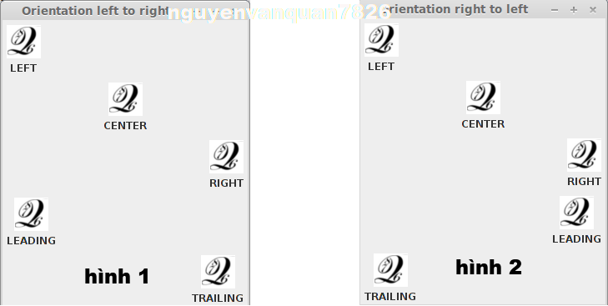
FlowLayout

Slide 24
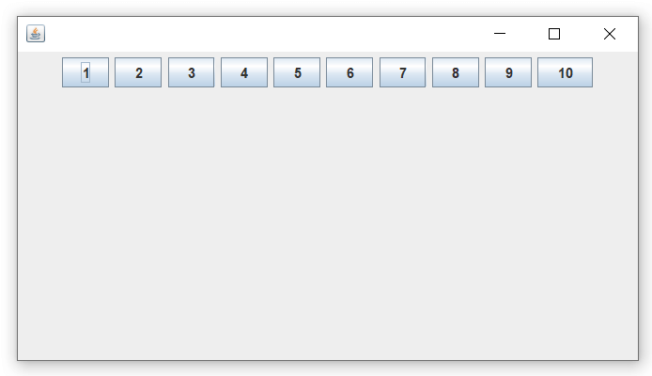
FlowLayout
public class FlowLayoutExample
{
JFrame frameObj;
FlowLayoutExample()
{
frameObj = new JFrame();
JButton b1 = new JButton("1");
JButton b2 = new JButton("2");
JButton b3 = new JButton("3");
JButton b4 = new JButton("4");
JButton b5 = new JButton("5");
JButton b6 = new JButton("6");
JButton b7 = new JButton("7");
JButton b8 = new JButton("8");
JButton b9 = new JButton("9");
JButton b10 = new JButton("10");
frameObj.add(b1); frameObj.add(b2); frameObj.add(b3); frameObj.add(b4);
frameObj.add(b5); frameObj.add(b6); frameObj.add(b7); frameObj.add(b8);
frameObj.add(b9); frameObj.add(b10);
// parameter less constructor is used therefore, alignment is center horizontal as well as the vertical gap is 5 units.
frameObj.setLayout(new FlowLayout());
frameObj.setSize(300, 300);
frameObj.setVisible(true);
}
public static void main(String argvs[])
{
new FlowLayoutExample();
}
}

Slide 25
BoxLayout
The Java BoxLayout class is used to arrange the components either vertically or horizontally. For this purpose, the BoxLayout class provides four constants.
public static final int X_AXIS: Alignment of the components are horizontal from left to right.
public static final int Y_AXIS: Alignment of the components are vertical from top to bottom.

Slide 26
BoxLayout
public static final int LINE_AXIS: Alignment of the components is similar to the way words are aligned in a line, which is based on the ComponentOrientation property of the container. If the ComponentOrientation property of the container is horizontal, then the components are aligned horizontally; otherwise, the components are aligned vertically. For horizontal orientations, we have two cases: left to right, and right to left. If the value ComponentOrientation property of the container is from left to right, then the components are rendered from left to right, and for right to left, the rendering of components is also from right to left. In the case of vertical orientations, the components are always rendered from top to bottom.
public static final int PAGE_AXIS: Alignment of the components is similar to the way text lines are put on a page, which is based on the ComponentOrientation property of the container. If the ComponentOrientation property of the container is horizontal, then components are aligned vertically; otherwise, the components are aligned horizontally. For horizontal orientations, we have two cases: left to right, and right to left. If the value ComponentOrientation property of the container is also from left to right, then the components are rendered from left to right, and for right to left, the rendering of components is from right to left. In the case of vertical orientations, the components are always rendered from top to bottom.

Slide 27
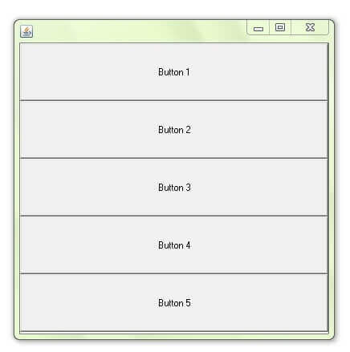
BoxLayout
public class BoxLayoutExample1 extends Frame {
Button buttons[];
public BoxLayoutExample1 () {
buttons = new Button [5];
for (int i = 0;i<5;i++) {
buttons[i] = new Button ("Button " + (i + 1));
// adding the buttons so that it can be displayed
add (buttons[i]);
}
// the buttons will be placed horizontally
setLayout (new BoxLayout (this, BoxLayout.Y_AXIS));
setSize(400,400);
setVisible(true);
}
// main method
public static void main(String args[]){
BoxLayoutExample1 b=new BoxLayoutExample1();
}
}

Slide 28
CardLayout
The Java CardLayout class manages the components in such a manner that only one component is visible at a time. It treats each component as a card that is why it is known as CardLayout.
CardLayout(): creates a card layout with zero horizontal and vertical gap.
CardLayout(int hgap, int vgap): creates a card layout with the given horizontal and vertical gap.
public void next(Container parent): is used to flip to the next card of the given container.
public void previous(Container parent): is used to flip to the previous card of the given container.
public void first(Container parent): is used to flip to the first card of the given container.
public void last(Container parent): is used to flip to the last card of the given container.
public void show(Container parent, String name): is used to flip to the specified card with the given name.

Slide 29
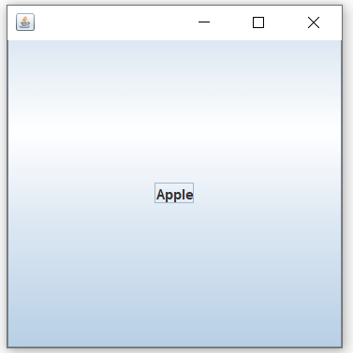
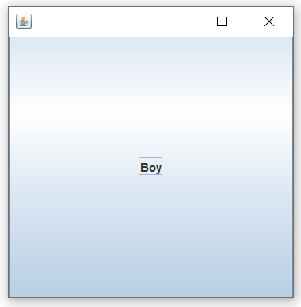
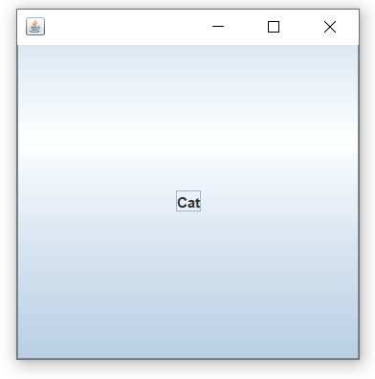
CardLayout
public class CardLayoutExample1 extends JFrame implements ActionListener
{
CardLayout crd;
JButton btn1, btn2, btn3;
Container cPane;
CardLayoutExample1()
{
cPane = getContentPane();
//default constructor used therefore, components will
// cover the whole area
crd = new CardLayout();
cPane.setLayout(crd);
btn1 = new JButton("Apple");
btn2 = new JButton("Boy");
btn3 = new JButton("Cat");
// adding listeners to it
btn1.addActionListener(this);
btn2.addActionListener(this);
btn3.addActionListener(this);
cPane.add("a", btn1);
cPane.add("b", btn2);
cPane.add("c", btn3);
}
public void actionPerformed(ActionEvent e)
{
// Upon clicking the button, the next card of the container is shown
// after the last card, again, the first card of the container is shown upon clicking
crd.next(cPane);
}
public static void main(String argvs[])
{
CardLayoutExample1 crdl = new CardLayoutExample1();
// size is 300 * 300
crdl.setSize(300, 300);
crdl.setVisible(true);
crdl.setDefaultCloseOperation(EXIT_ON_CLOSE);
}
}

Slide 30
GridBagLayout
The Java GridBagLayout class is used to align components vertically, horizontally or along their baseline.
The components may not be of the same size. Each GridBagLayout object maintains a dynamic, rectangular grid of cells. Each component occupies one or more cells known as its display area.

Slide 31
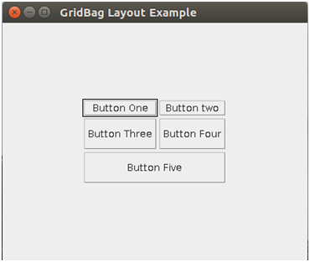
GridBagLayout
public class GridBagLayoutExample extends JFrame{
public static void main(String[] args) {
GridBagLayoutExample a = new GridBagLayoutExample();
}
public GridBagLayoutExample() {
GridBagLayoutgrid = new GridBagLayout();
GridBagConstraints gbc = new GridBagConstraints();
setLayout(grid);
setTitle("GridBag Layout Example");
GridBagLayout layout = new GridBagLayout();
this.setLayout(layout);
gbc.fill = GridBagConstraints.HORIZONTAL;
gbc.gridx = 0;
gbc.gridy = 0;
this.add(new Button("Button One"), gbc);
gbc.gridx = 1;
gbc.gridy = 0;
this.add(new Button("Button two"), gbc);
gbc.fill = GridBagConstraints.HORIZONTAL;
gbc.ipady = 20;
gbc.gridx = 0;
gbc.gridy = 1;
this.add(new Button("Button Three"), gbc);
gbc.gridx = 1;
gbc.gridy = 1;
this.add(new Button("Button Four"), gbc);
gbc.gridx = 0;
gbc.gridy = 2;
gbc.fill = GridBagConstraints.HORIZONTAL;
gbc.gridwidth = 2;
this.add(new Button("Button Five"), gbc);
setSize(300, 300);
setPreferredSize(getSize());
setVisible(true);
setDefaultCloseOperation(EXIT_ON_CLOSE);
}
}

Slide 32
GroupLayout
GroupLayout groups its components and places them in a Container hierarchically. The grouping is done by instances of the Group class.
Group is an abstract class, and two concrete classes which implement this Group class are SequentialGroup and ParallelGroup.
SequentialGroup positions its child sequentially one after another whereas ParallelGroup aligns its child on top of each other.
The GroupLayout class provides methods such as createParallelGroup() and createSequentialGroup() to create groups.

Slide 33

GroupLayout
public class GroupExample {
public static void main(String[] args) {
JFrame frame = new JFrame("GroupLayoutExample");
frame.setDefaultCloseOperation(JFrame.EXIT_ON_CLOSE);
Container contentPanel = frame.getContentPane();
GroupLayout groupLayout = new GroupLayout(contentPanel);
contentPanel.setLayout(groupLayout);
JLabel clickMe = new JLabel("Click Here");
JButton button = new JButton("This Button");
groupLayout.setHorizontalGroup(
groupLayout.createSequentialGroup()
.addComponent(clickMe)
.addGap(10, 20, 100)
.addComponent(button));
groupLayout.setVerticalGroup(
groupLayout.createParallelGroup(GroupLayout.Alignment.BASELINE)
.addComponent(clickMe)
.addComponent(button));
frame.pack();
frame.setVisible(true);
} }

Slide 34
SpringLayout
A SpringLayout arranges the children of its associated container according to a set of constraints. Constraints are nothing but horizontal and vertical distance between two-component edges. Every constraint is represented by a SpringLayout.Constraint object.
Each child of a SpringLayout container, as well as the container itself, has exactly one set of constraints associated with them.

Slide 35
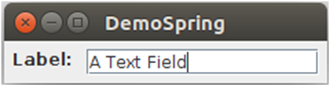
SpringLayout
public class MySpringDemo {
private static void createAndShowGUI() {
JFrame frame = new JFrame("MySpringDemp");
frame.setDefaultCloseOperation(JFrame.EXIT_ON_CLOSE);
Container contentPane = frame.getContentPane();
SpringLayout layout = new SpringLayout();
contentPane.setLayout(layout);
JLabel label = new JLabel("Label: ");
JTextField textField = new JTextField("My Text Field", 15);
contentPane.add(label);
contentPane.add(textField);
layout.putConstraint(SpringLayout.WEST, label,6,SpringLayout.WEST, contentPane);
layout.putConstraint(SpringLayout.NORTH, label,6,SpringLayout.NORTH, contentPane);
layout.putConstraint(SpringLayout.WEST, textField,6,SpringLayout.EAST, label);
layout.putConstraint(SpringLayout.NORTH, textField,6,SpringLayout.NORTH, contentPane);
layout.putConstraint(SpringLayout.EAST, contentPane,6,SpringLayout.EAST, textField);
layout.putConstraint(SpringLayout.SOUTH, contentPane,6,SpringLayout.SOUTH, textField);
frame.pack();
frame.setVisible(true);
}
public static void main(String[] args) {
javax.swing.SwingUtilities.invokeLater(new Runnable() {
public void run() {
createAndShowGUI();
}
});
}}

Slide 36
ScrollPaneLayout
The layout manager is used by JScrollPane. JScrollPaneLayout is responsible for nine components: a viewport, two scrollbars, a row header, a column header, and four "corner" components.

Slide 37
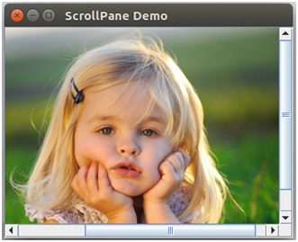
ScrollPaneLayout
import javax.swing.ImageIcon;
import javax.swing.JFrame;
import javax.swing.JLabel;
import javax.swing.JScrollPane;
public class ScrollPaneDemo extends JFrame
{
public ScrollPaneDemo() {
super("ScrollPane Demo");
ImageIcon img = new ImageIcon("child.png");
JScrollPane png = new JScrollPane(new JLabel(img));
getContentPane().add(png);
setSize(300,250);
setVisible(true);
}
public static void main(String[] args) {
new ScrollPaneDemo();
}
}

Slide 38
Check Boxes and Radio Buttons
JRadioButton myRButton=new RadioButton(“my radio button”);
Content.add(myRButton);
JRadioButton myRButton=new RadioButton(“my radio button”);
Content.add(myRButton);

Slide 39
Adding Group of Radio Buttons
//Creating Radio Group
ButtonGroup radioGroup = new ButtonGroup();
//add a radio button
JRadioButton myRadioButton=new JRadioButton("Red");
content.add(myRadioButton);
radioGroup.add(myRadioButton);
//add another radio button
JRadioButton anotherRadioButton=new JRadioButton("Green");
content.add(anotherRadioButton);
radioGroup.add(anotherRadioButton);

Slide 40
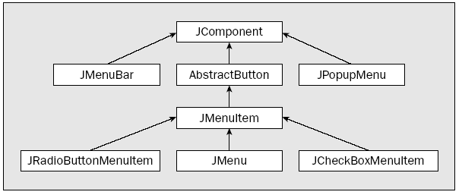
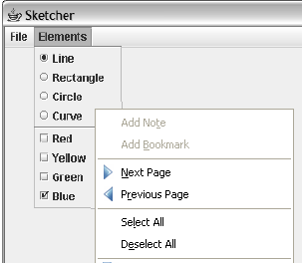
Swing Menus

Slide 41
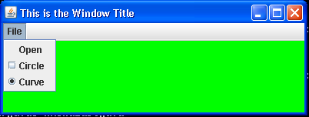
Adding Menu to a Window
// Create a menu Bar
JMenuBar menuBar = new JMenuBar();
//setting a menu bar of a window
Awindow.setJMenuBar(menuBar);
//Creating a menu
JMenu fileMenu = new JMenu(“File”);
//adding menu to menu bar
menuBar.add(fileMenu);
//Creating and adding menu items
JMenuItem openMenu = new JMenuItem(“Open”);
fileMenu.add(openMenu);
JCheckboxMenuItem circleItem = new JCheckboxMenuItem(“Circle”);
fileMenu.add(circleItm);
JRadioButtonMenuItem curveItem = new JRadioButtonMenuItem(“Curve”, true);
fileMenu.add(curveItem);

Slide 42
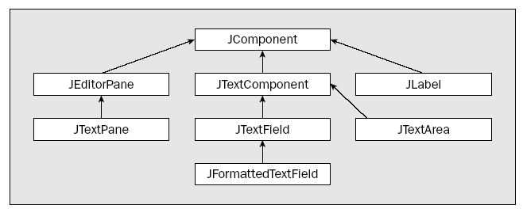
Swing Text Components

Slide 43


Other important Swing components
JPanel
The JPanel class defines something like a physical panel that you can use as a container to group a set of components
JTable
JTable component implements a table of items from which you can select a row, a column, or a single element.
JList
A JList component implements a list of items with a line border around it.

Slide 44
Containers

Slide 45
Containers
A container is any component of a type that has the Container class as a base; so all the Swing components are containers
The Container class is the direct base class for the Window class, and it provides the capability for a window to contain other components
Since the Container class is an abstract class, you cannot create instances of Container

Slide 46
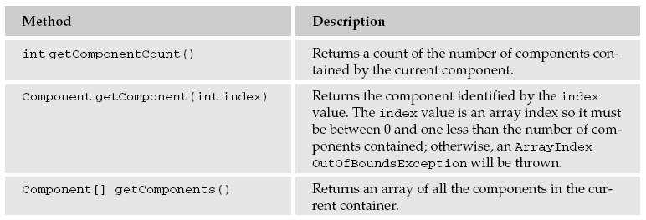
Getting objects contained in a container

Slide 47
To Do List
Create a Graphical User Interface of your Project using the Swing Package
Add buttons menus and other swing items to make the interface interactive

